Slide 1
Ant Colony Optimization
Achilleas Tsakpinis
ITI0210 Foundations of Artificial Intelligence and Machine Learning
20.09.2022

Slide 2


Algortihm (1/9)
Prerequisites
Cost matrix
Pheromone matrix
$$\begin{matrix} & A & B & C & D \\ A & 0 & 5 & 15 & 4 \\ B & 5 & 0 & 4 & 8 \\ C & 15 & 4 & 0 & 1 \\ D & 4 & 8 & 1 & 0\end{matrix}$$
$\begin{matrix} & A & B & C & D \\ A & 0 & 4 & 10 & 3 \\ B & 4 & 0 & 1 & 2 \\ C & 10 & 1 & 0 & 1 \\ D & 3 & 2 & 1 & 0\end{matrix}$
D
D
4
1
3
1
A
15
C
A
10
C
8
2
5
4
4
1
B
B

Slide 3

Algortihm (2/9)
Formulas
${∆τ}_{i,j}^{k}= \left\{\begin{aligned}\frac{1}{L_{k}} k th ant travels on the edge i,j \\ 0 otherwise\end{aligned}\right.$
$τ_{i,j}^{k}= \sum_{k=1}^{m}{{∆τ}_{i,j}^{k}}$ without vaporization
$τ_{i,j}^{k}=\left(1−ρ\right)τ_{i,j} \sum_{k=1}^{m}{{∆τ}_{i,j}^{k}}$ with vaporization

Slide 4

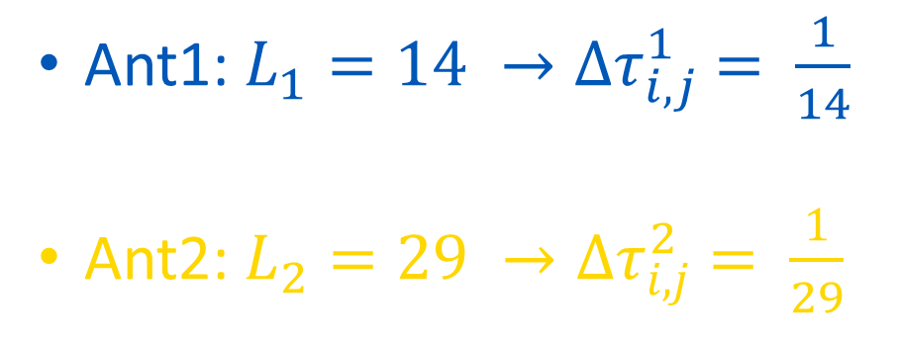
Algortihm (3/9)
Cost Graph
Pheromone Graph
D
D
4
1
1/14
1/14 + 1/29
15
1/29
A
C
A
C
8
1/29
5
4
1/14 + 1/29
1/14
B
B
Ant1: $L_{1}=14 →{∆τ}_{i,j}^{1} = \frac{1}{14}$
Ant2: $L_{2}=29 →{∆τ}_{i,j}^{2} = \frac{1}{29}$
$τ_{i,j}^{k}= \sum_{k=1}^{m}{{∆τ}_{i,j}^{k}}$

Slide 5
Algortihm (4/9)
Cost Graph
Pheromone Graph
D
D
4
1
0.07
0.07 + 0.03
15
0.03
A
C
A
C
8
0.03
5
4
0.07 + 0.03
0.07
B
B
Ant1: $L_{1}=14 →{∆τ}_{i,j}^{1} = \frac{1}{14}$
Ant2: $L_{2}=29 →{∆τ}_{i,j}^{2} = \frac{1}{29}$
$τ_{i,j}^{k}= \sum_{k=1}^{m}{{∆τ}_{i,j}^{k}}$

Slide 6

Algortihm (5/9)
Cost Graph
Pheromone Graph
D
D
1
4
1
1
15
1
A
C
A
C
8
1
5
4
1
1
B
B
Ant1: $L_{1}=14 →{∆τ}_{i,j}^{1} = \frac{1}{14}$
Ant2: $L_{2}=29 →{∆τ}_{i,j}^{2} = \frac{1}{29}$
$τ_{i,j}^{k}=\left(1−ρ\right)τ_{i,j}\sum_{k=1}^{m}{{∆τ}_{i,j}^{k}}$

Slide 7

Algortihm (6/9)
Cost Graph
Pheromone Graph
D
D
0.5*1 + 0.07 + 0.03
4
1
0.5*1 + 0.07
15
0.5+0.03
A
C
A
C
0.5+0.03
8
5
4
0.5*1 + 0.07 + 0.03
0.5*1 + 0.07
B
B
Ant1: $L_{1}=14 →{∆τ}_{i,j}^{1} = \frac{1}{14}$
Ant2: $L_{2}=29 →{∆τ}_{i,j}^{2} = \frac{1}{29}$
$τ_{i,j}^{k}=\left(1−ρ\right)τ_{i,j}\sum_{k=1}^{m}{{∆τ}_{i,j}^{k}}$
$ρ$ = 0.5

Slide 8

Algortihm (7/9)
Probalility
D
$P_{i,j}= \frac{{(τ_{i,j})}^{α} {(η_{i,j})}^{β}}{\sum{\left({(τ_{i,j})}^{α} {(η_{i,j})}^{β}\right)}}$
$η_{i,j}= \frac{1}{L_{i,j}}$
$τ_{i,j}=1$
1
1
1
A
C
1
1
1
B

Slide 9



Algortihm (8/9)
D
1
$P_{A,D}= \frac{1 ∗ \frac{1}{4}}{\left(1 ∗ \frac{1}{4}\right)+\left(1 ∗ \frac{1}{15}\right)+\left(1 ∗ \frac{1}{5}\right)}=0.48$
4
15
A
C
8
5
4
D
B
4
15
$P_{A,C}= \frac{1 ∗ \frac{1}{15}}{\left(1 ∗ \frac{1}{4}\right)+\left(1 ∗ \frac{1}{15}\right)+\left(1 ∗ \frac{1}{5}\right)}=0.12$
A
C
D
1
5
1
B
1
A
C
$P_{A,B}= \frac{1 ∗ \frac{1}{5}}{\left(1 ∗ \frac{1}{4}\right)+\left(1 ∗ \frac{1}{15}\right)+\left(1 ∗ \frac{1}{5}\right)}=0.4$
1
1
1
B

Slide 10


Algortihm (9/9)
$$\left\{\begin{aligned}0.52<r≤1.00 \\ 0.12<r≤0.52 \\ 0.00≤r≤0.12 \end{aligned}\right.$$
$${Go from A to D \atop \begin{aligned}Go from A to B \\ Go from A to C\end{aligned}}$$
For a random number r in [0,1]
D
48%
12%
A
C
40%
B

Slide 11
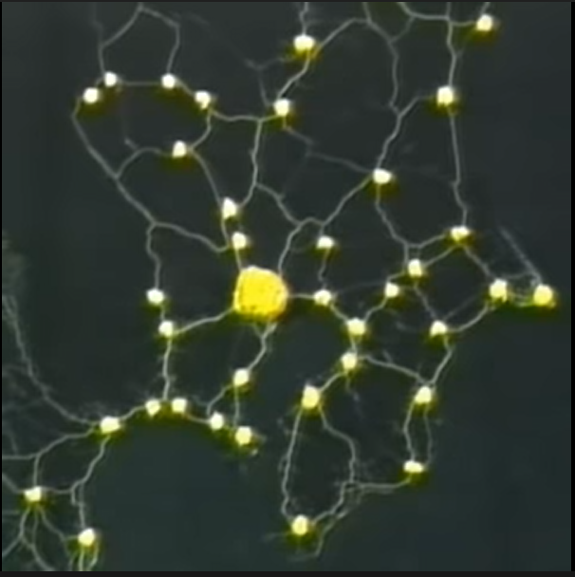
Example
Slime mold form a map of the
Tokyo-area railway system

